Slide 1
If you will be at the tutorials and haven’t done it yet,
download and install Anaconda:
https://www.anaconda.com/products/distribution

Slide 2
Building the Jupyter Community in MSK Imaging Research
9-11 June 2022
Maastricht, The Netherlands

Slide 3
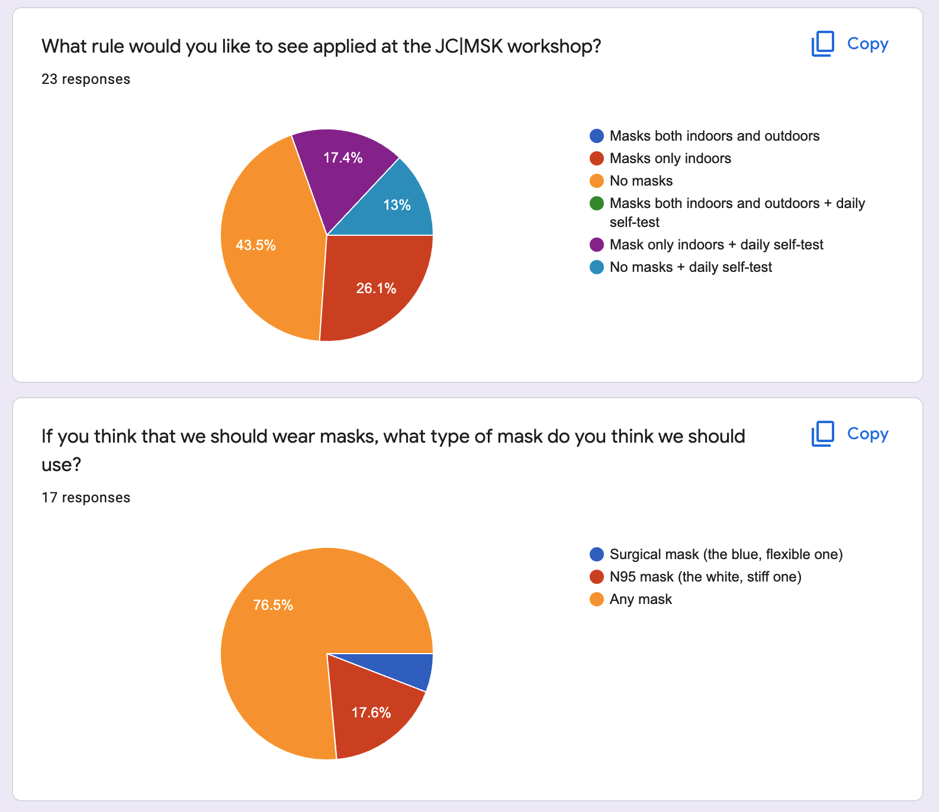
Safety measures
23 people replied to the 1st question
Absolute preferences (< 50%): no mask (43.5%, 10 people)
Cumulative preferences (>50%): 56.5% (13 people) voted for some form of protection:
43.5% (10 people) voted for at least mask
Mask only indoors + daily self-test (17.4%, 4 people) +
Masks only indoors (26.1%, 6 people)
30.4% (7 people) voted for at least test (I
Mask only indoors + daily self-test (17.4%, 4 people) +
No masks + daily self-test (13%, 3 people)
What mask? Any mask (76.5%, 13 people out of 17)

Slide 4
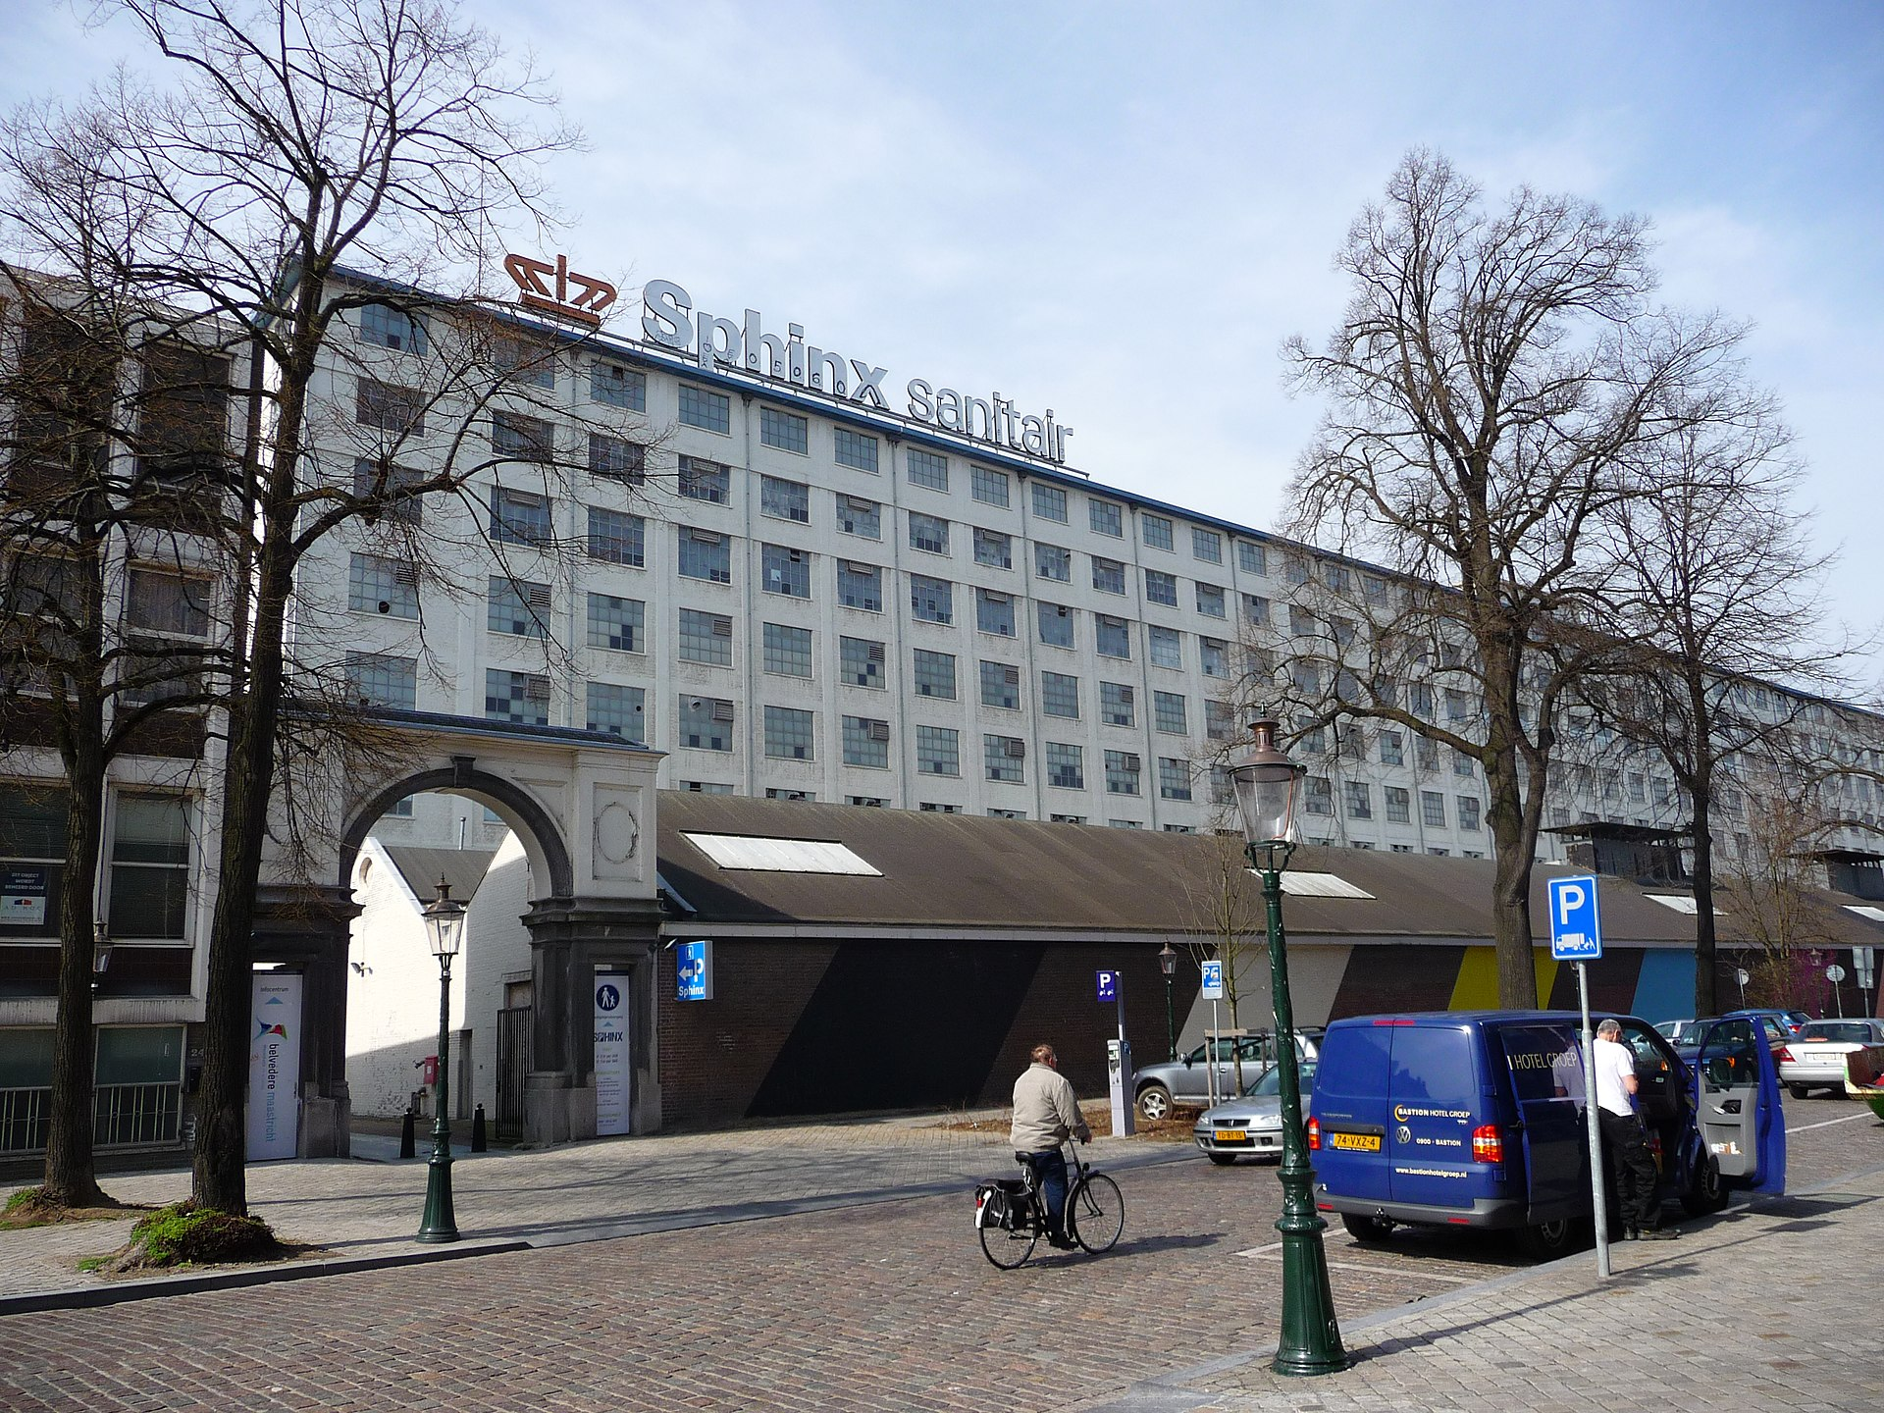
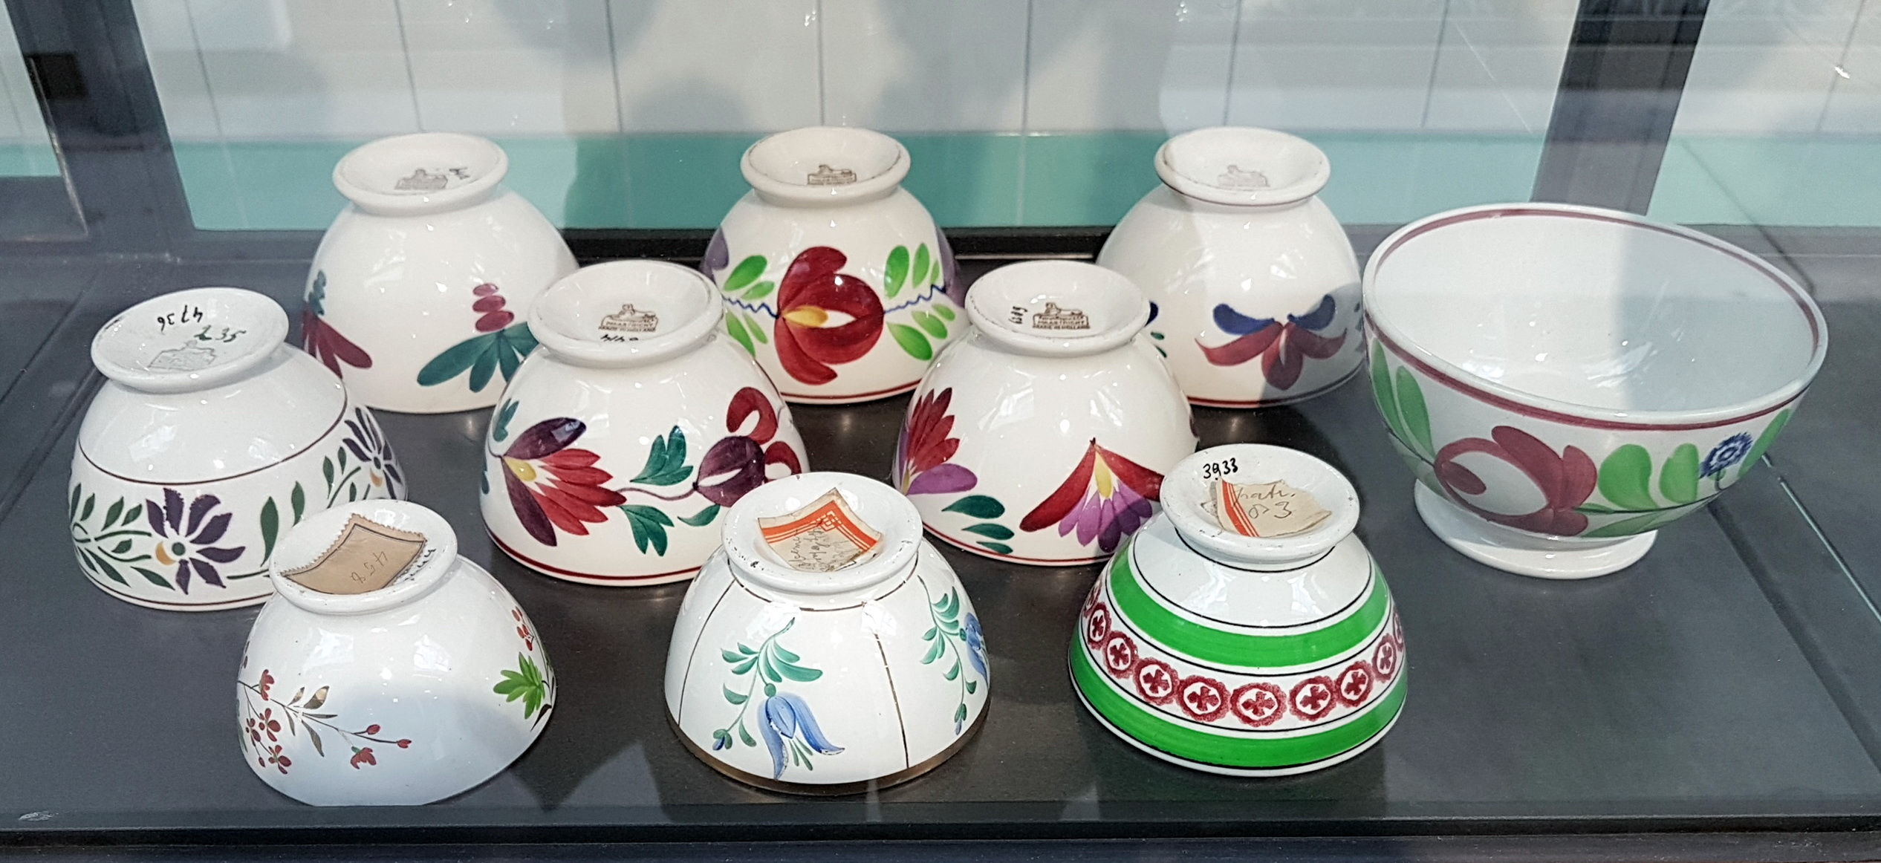
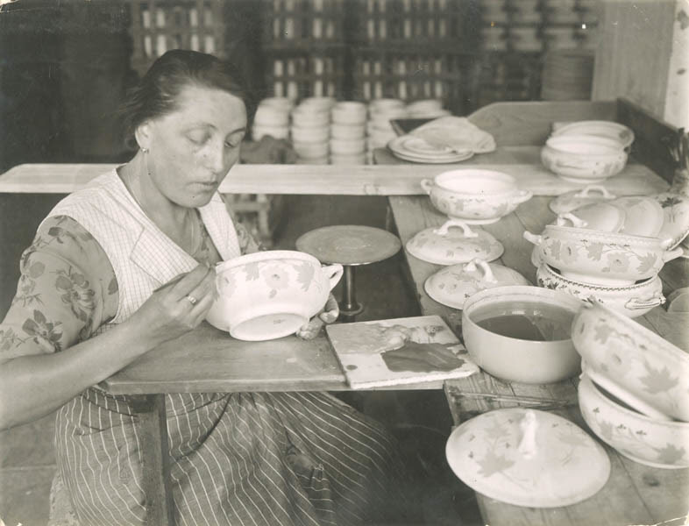
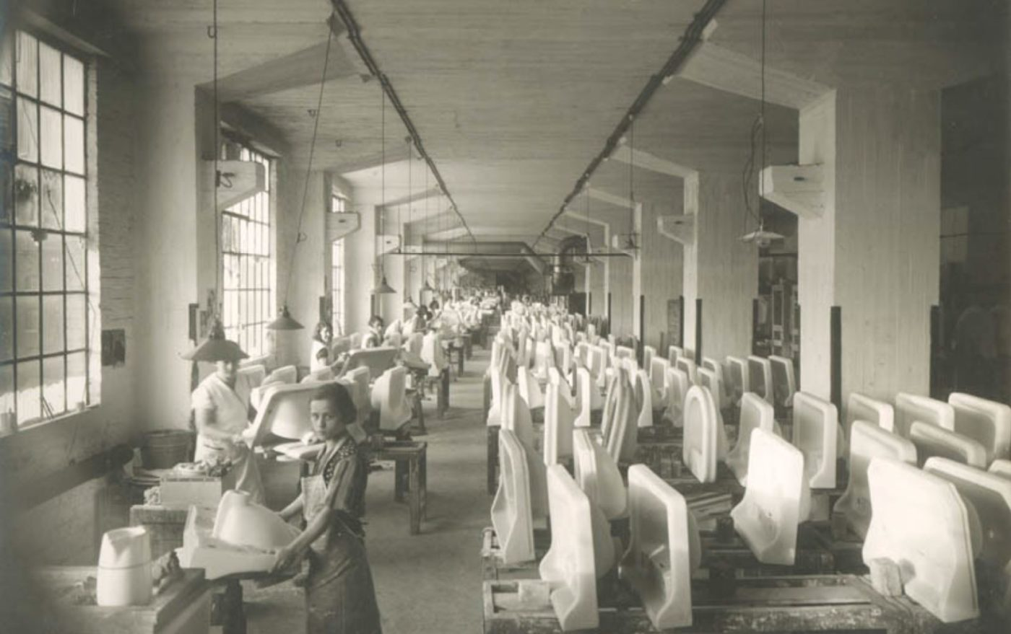
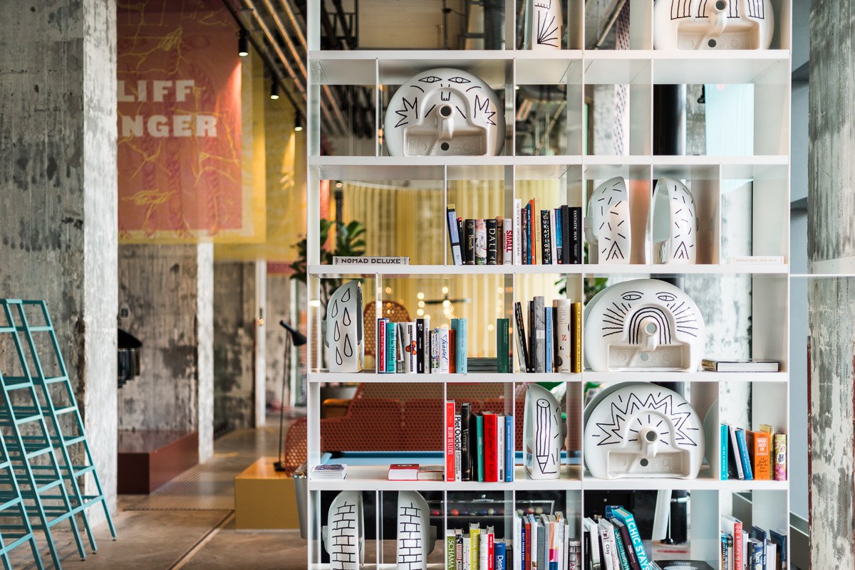
The Sphinxkwartier
The Eiffel building was the production site of Sphinx (1834-2009)
Production of pottery, tiles, and sanitary ware
Today it hosts The Student Hotel and the Pathé movie theater

Slide 5
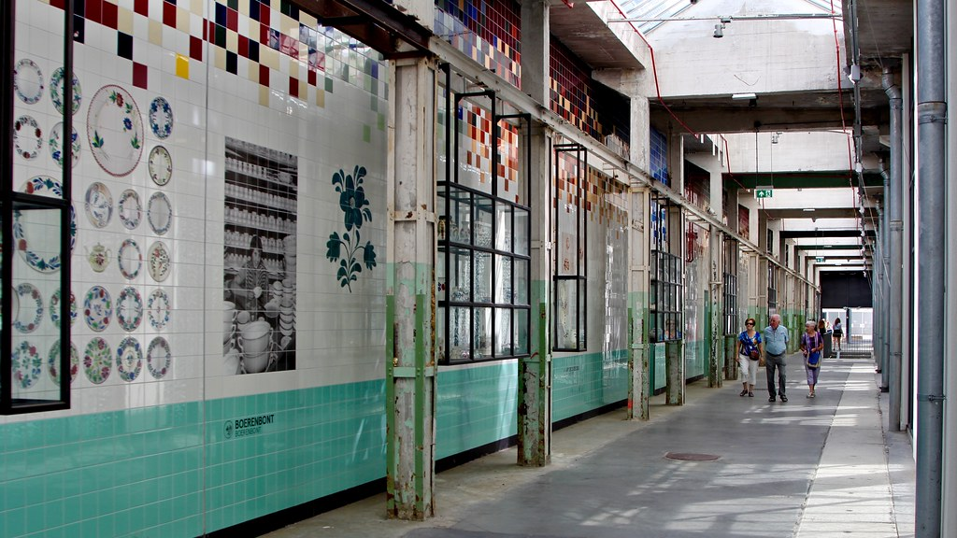
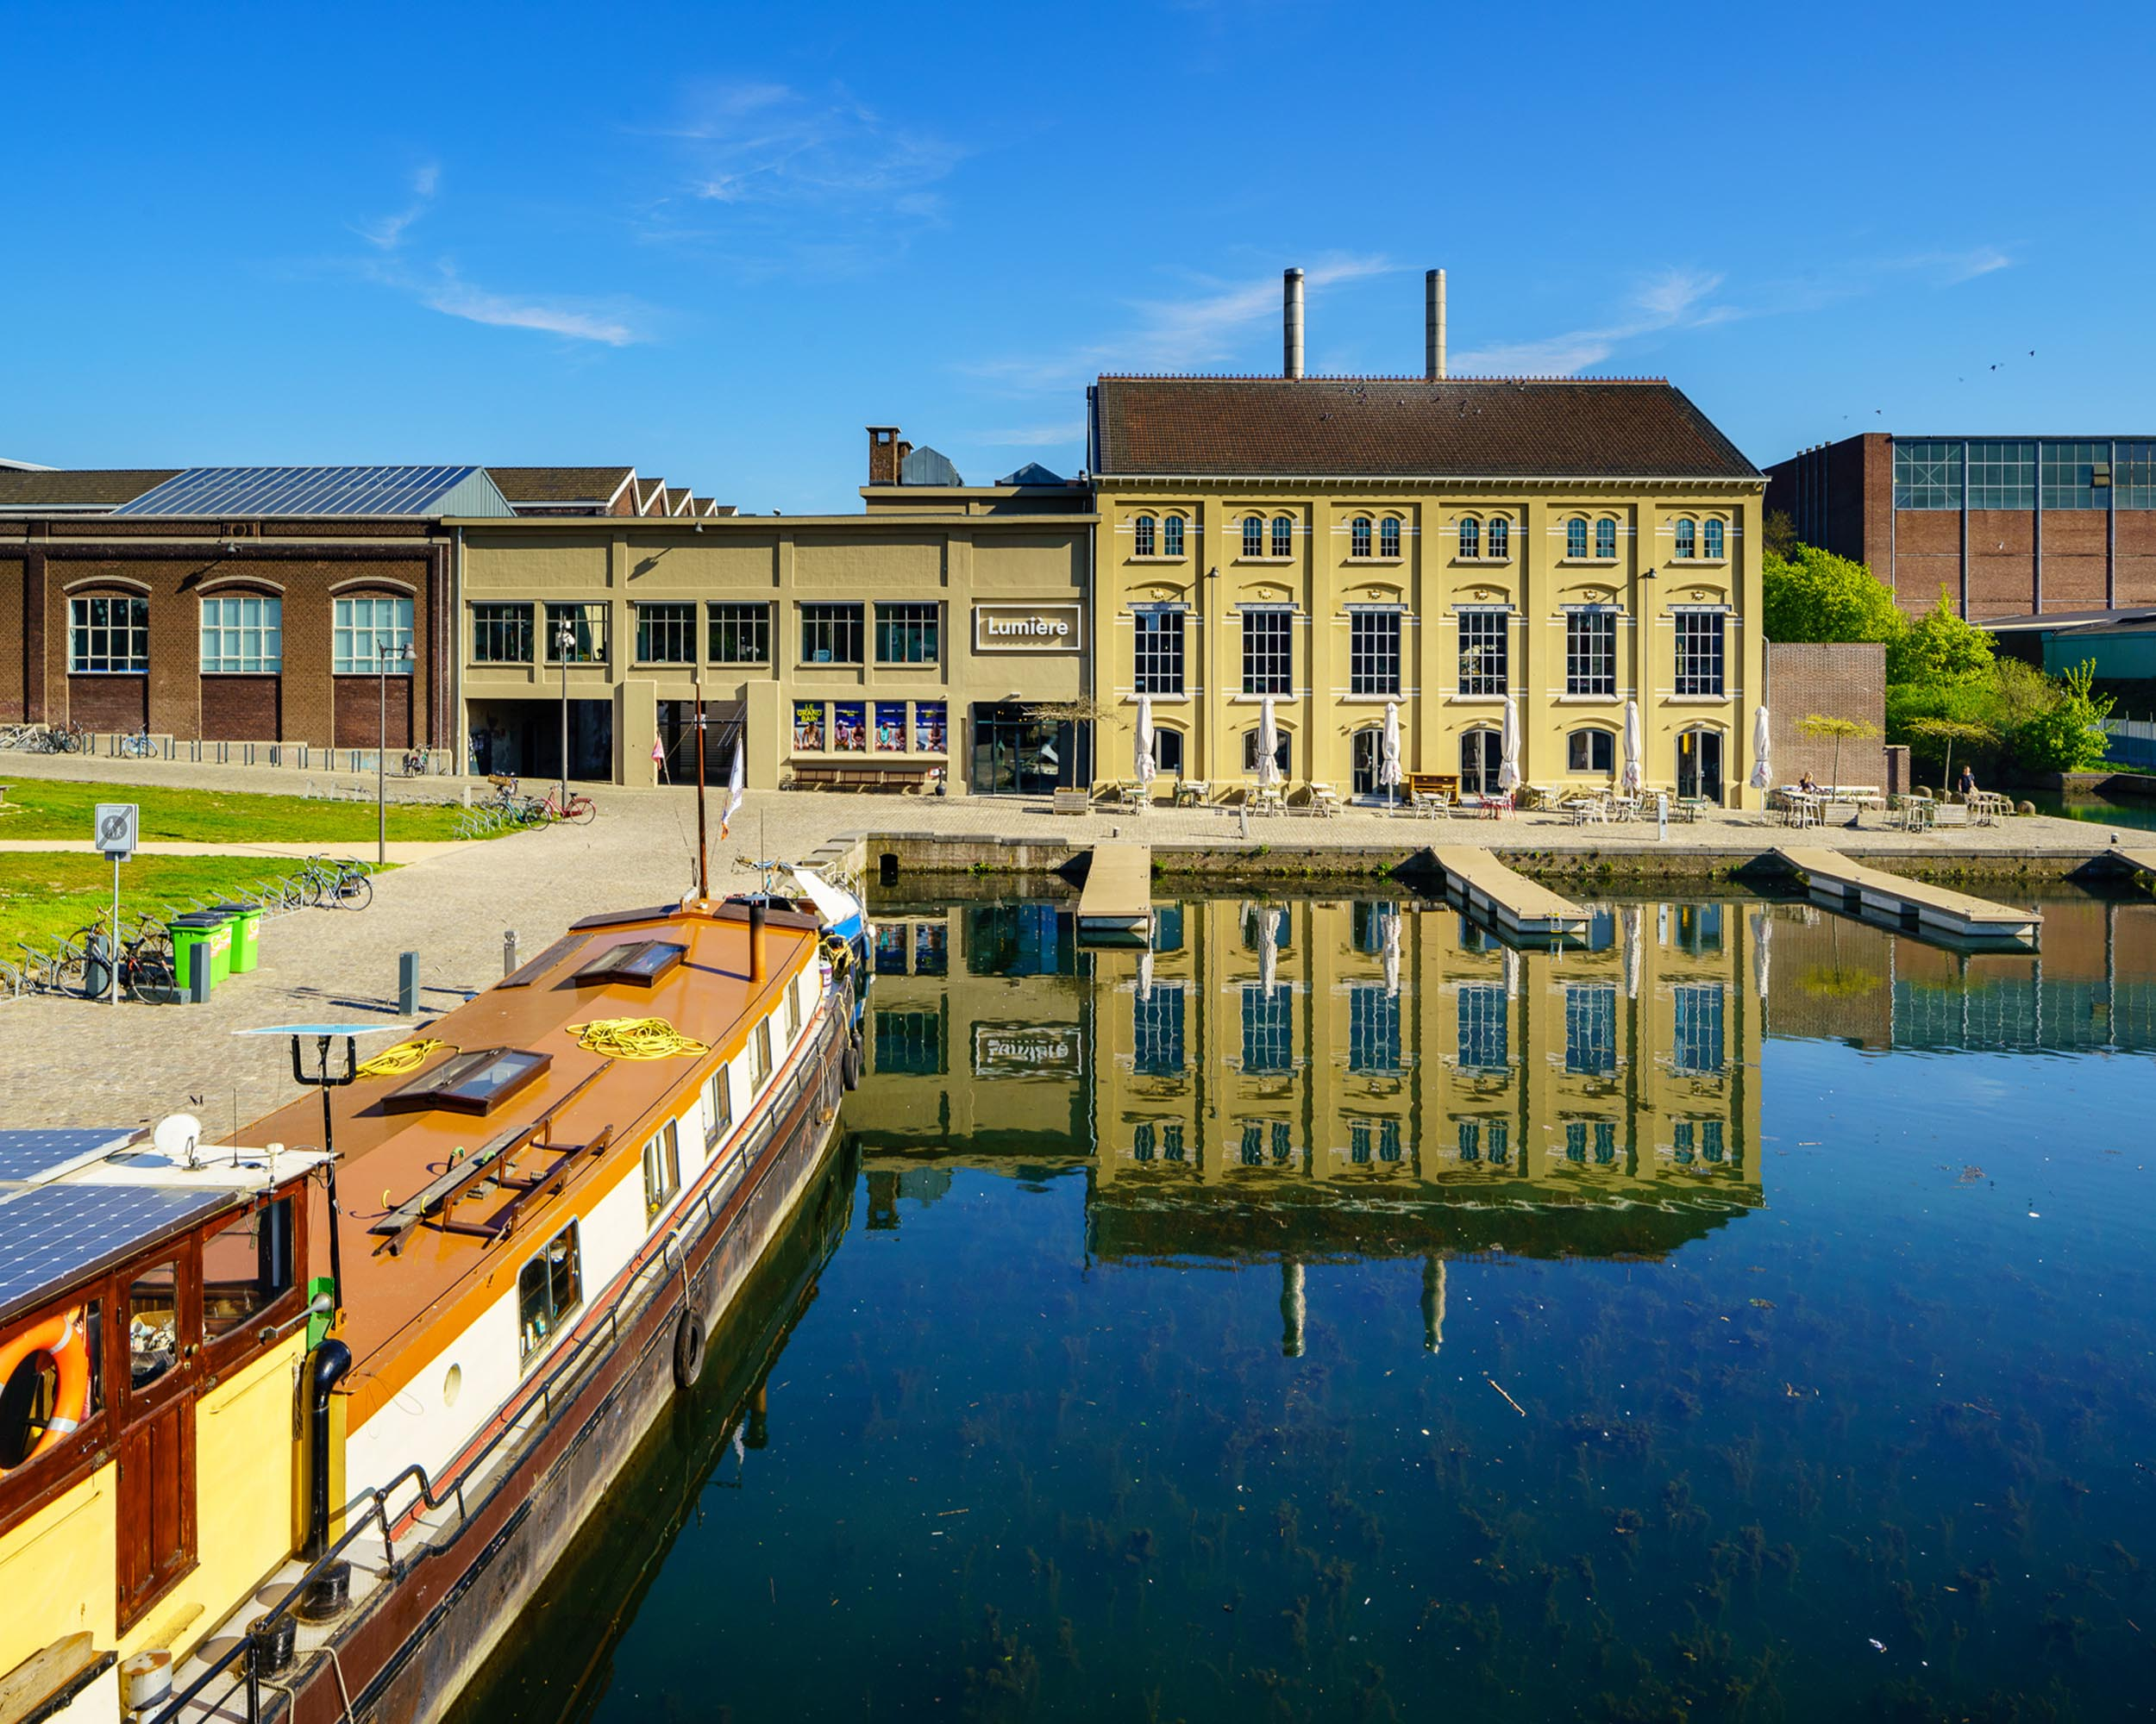
The Sphinxkwartier
Sphinxpassage
120m corridor with 30,000 tiles narrating the story of Sphinx
Lumière (restaurant + movies)
Former power plants of the Sphinx factories
Today it hosts a restaurant and the movie theater
Bassin
Goods were unloaded and stored
https://sphinxkwartier.nl/en

Slide 6
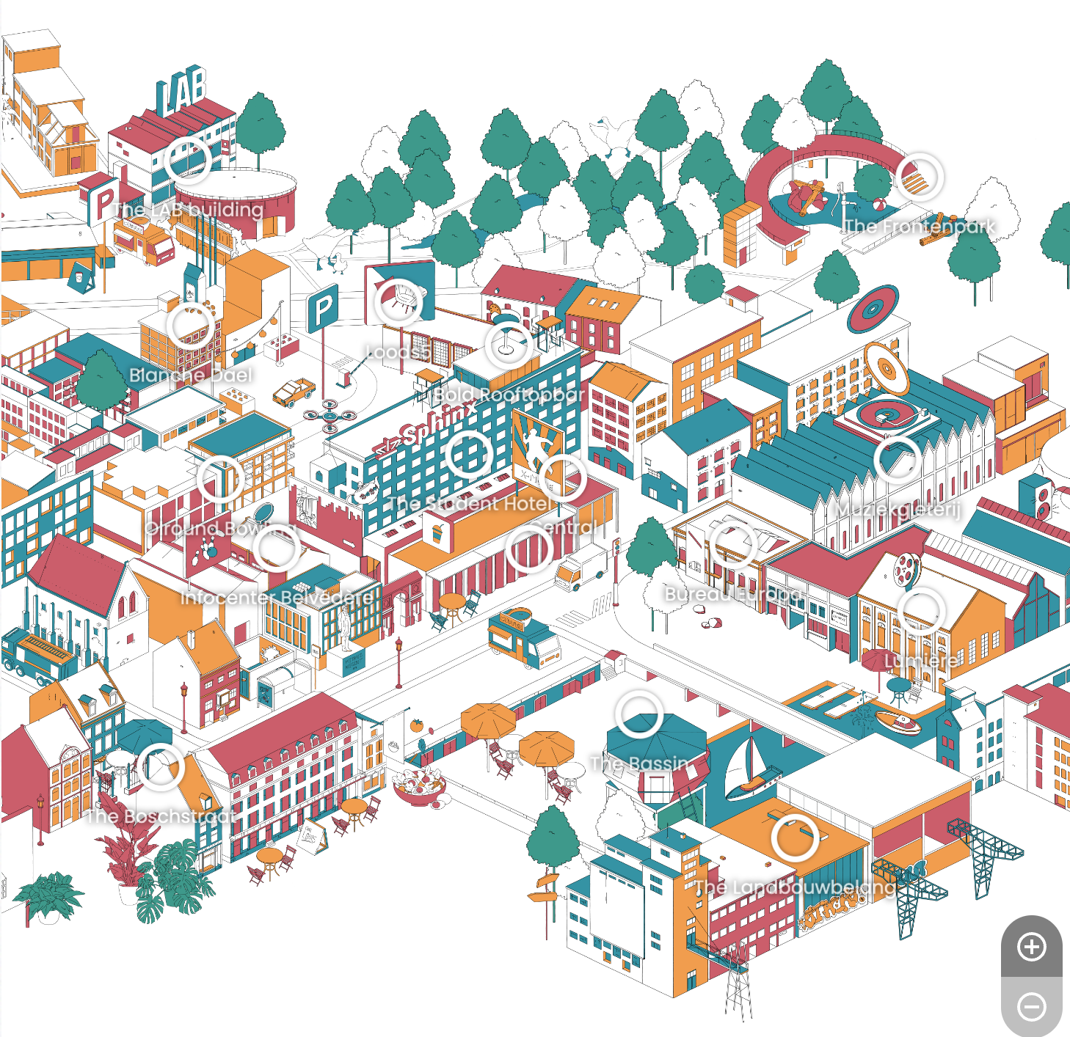
The Sphinxkwartier
https://sphinxkwartier.nl/en

Slide 7
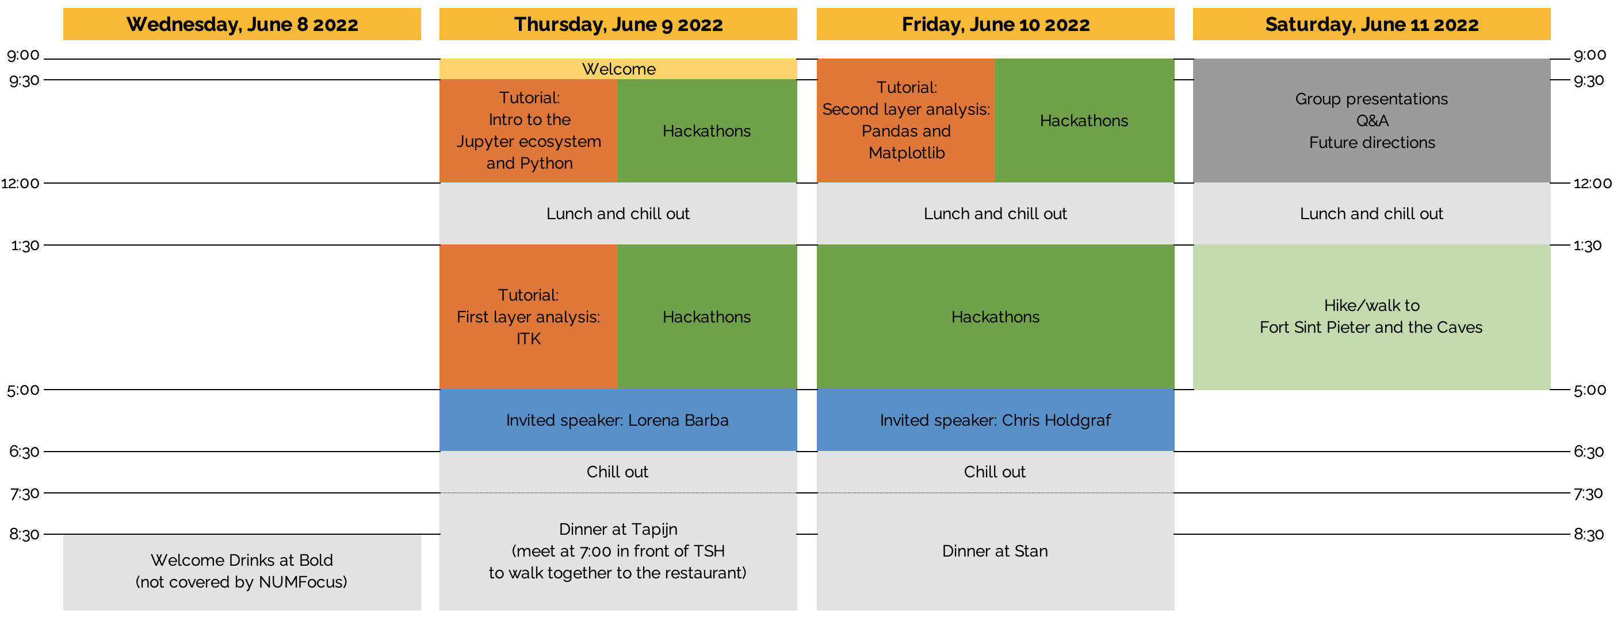
Program

Slide 8
Tutorials
Tutorial 1 (Thu, 9:30 - 12:00)
Introduction to the Jupyter ecosystem and Python (Serena)
Tutorial 2 (Thu, 1:00-5:00)
First layer analysis: Image processing and analysis with ITK (Dženan and Jared)
Tutorial 3 (Fri, 9:00-12:00)
Second layer analysis: Pandas and Matplotlib (Serena)

Slide 9
Hackathons
HR-pQCT imaging (Michael, Nathan)
Biomechanics (Gianluca, Martino, Gianluigi)
Muscle imaging data management (Francesco)
Please, follow the coding guidelines at https://jcmsk.github.io/for_contributors.html
Write code for human beings!

Slide 10
Special sessions
Invited speakers
Lorena Barba
Chris Holdgraf
Group presentations | Q&A | Future directions
Add your questions at https://tinyurl.com/jcwmsk-q
Notes:
2i2c

Slide 11
Meals
Choices and requirements in the badge
Coffee breaks
Unlimited!
Lunch
Served in the breakfast area (entrance)
Dinner on Thu
Meet at 7pm in front of TSH to walk to the restaurant
Tapijn allows us to make only 1 single payment, so please do not order anything extra unless they allow you to pay separately!
Dinner on Fri
At Stan, next door
Can order your own extras at the bar

Slide 12
Last but not least
Hike/walk on Saturday afternoon
The weather should be nice!
Who wants to be the official photographer?
Pictures during tutorials, hackathons, social events
Feel free to share on social media
Everybody agreed on sharing pics

